Slide 1
INDOOR FARM ASSISTANCE
BATCH 7
Team Members:
ROJIN RAJU
SRI SAKTICHARAN N
UMESH HARIHARA SUDAN M
Mentor :
Sadasivam S
Assistant Professor / ECE
`

Slide 2

Objective of the Project
To design a module containing all necessary sensors, power supply and controllers to monitor growth and development of plants in a home farm.
To provide a proper wireless communication media and API for the module to transfer data to end user devices
To create a simple user friendly interface to monitor and control the parameters like temperature, soil moisture, light intensity, ph.. etc. accordingly
To produce better yield under controlled environment without being affected by unpredicted severe climatic changes .

Slide 3
Introduction
Climate change and population increase are some major threats to the community. Climate change has caused a rise of 1 degree in earths temperature. Continued changes in the frequency and intensity of precipitation, heat waves, and other extreme events are likely, all which will impact agricultural production. Furthermore, compounded climate factors can decrease plant productivity, resulting in price increases for many important agricultural crops. Global food production patterns would be fundamentally altered by climate change, causing food insecurity, Increase in demand for food because of small shifts in seasonality and water availability.
“The Great threat to our planet is the belief that someone will save it.We have taken up this problem to be the someone that everyone is expecting.”

Slide 4



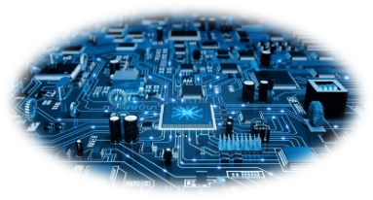

Tools required
IOT
  Embedding sensors
  Microprocessor encoding
  Internet via cloud
ECAD
App Development
Data Science

Slide 5
Project Description
These seeds are kept in arrays of tubes and kept under intensive care till the first leaves starts to show.
The germinated seeds are the provided with constant flow of a hydroponic solution
The tubes are stacked vertically to use more space.
Atmospheric Temperature of the room is controlled using foggers , moisturizing valves and LEDs(used to provide proper wavelength of light).
The crops will be constantly monitored using sensors to sense their temperature, nutrition absorbed, growth rate, probable yield,etc.
These monitored values can be easily viewed via an app.
Since the process is fully automated no work needed during the growth process.
After the harvest , the crops are stored in a place with Atmosphere control to increase the shelf life.
Unique Point:
Controlling the room conditions. with IoT.
Sterilizing and adding the required nutrients automatically according to the plants profile.

Slide 6
The Indoor farm is the most logical way to overcome the issues of lack of land, water and resources.
In a hydroponic farm the crops are grown in the absence of soil with only the nutrient filled water given to the roots.
In order to make farming a more feasible alternative we can provide a fully automated and easily portable solution with the help of IOT.
This way people who are enthusiastic to try out vertical farming can easily exercise it, making vertical farming a more commercially viable solution.

Slide 7
Advantages of Proposed method over existing methods
Our Project aims to develop this project in a very minimalistic way so that
Everyone can operate it easily .
Cost Efficient and easily available.
Easy to setup.
We provide Controlled environment for the Plants to grow Using IOT and Machine learning.
Target audience is not MNC’s or Multi million dollar companies but Micro small and medium Industries.
Sterilizing the Water and using it again by adding required nutrients again automatically.
Moreover compared to Other similar product by MNC’s our Product is cheap and affordable.
Our product also provide atmosphere controlled Storage facility.
Can produce any types of crops year-round.

Slide 8
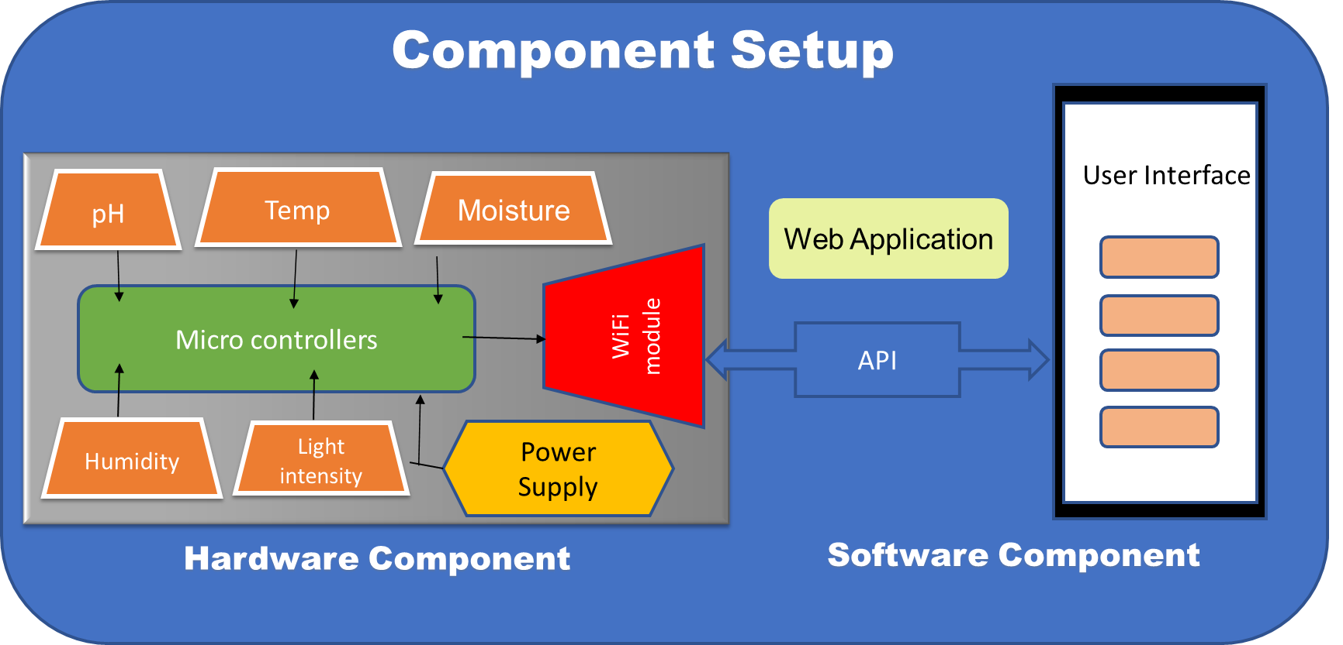
Component Setup

Slide 9
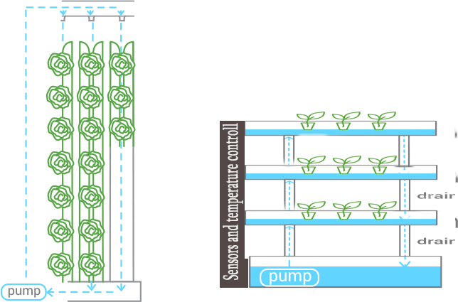
Diagram

Slide 10
Future Scope
The target beneficiaries for this project is anyone aspiring to make and sell off-season crops in the cityscape.
Our product can be used by hotels to obtain fresh crops.
Super markets and malls can also use this technology to provide fresh food much cheaper as transportation cost will not be an issue. They can grow plants in their premises.
This project aims to resolve the major problem that will faced by the community in future .(Taking the Increasing population in mind)
Round the year we can produce crops irrespective of the climatic conditions.

Slide 11
BUSINESS:
The cost in transporting the food crops from the field to market is cut down which results in increased profit.
The product can be easily brought into the market due to its affordability and accessibility.
The product can be customized as per the area of the building.
USERS:
The targeted users are modern farmers and organic farmers.
Small scale hyper markets and restaurants can adopt this technique and cultivate their supplies according to their needs which give a higher profit margin.
The available yield can be harvested fresh which in turn retains the nutrients.
However this can also be used by individuals as it doesn’t require field, heavy machineries and tools.

Slide 12
Application of your Proposed Solution:
The target beneficiaries for this project is anyone aspiring to make and sell off-season crops in the cityscape.
Our product can be used by hotels to obtain fresh crops.
Super markets and malls can also use this technology to provide fresh food much cheaper as transportation cost will not be an issue. They can grow plants in their premises.
This project aims to resolve the major problem that will faced by the community in future .(Taking the Increasing population in mind)
Round the year we can produce crops irrespective of the climatic conditions.

Slide 13
References
https://www.discovery.com/science/vertical-farming--raising-agriculture-s-potential-and-lowering-i
https://ssir.org/articles/entry/feeding_the_future_of_agriculture_with_vertical_farming
https://www.theguardian.com/environment/2019/dec/26/farming-of-the-future-rise-of-hydroponic-food-labs-thomas-myers

